Slide 1
But! It was Logged!
A practical look at logging with .NET Core

Slide 2

Who am I?
Mitchel Sellers
Microsoft MVP, ASPInsider, DNN MVP Microsoft Certified Professional
CEO – IowaComputerGurus, Inc. (USA)
Contact Information
msellers@iowacomputergurus.com GitHub: github.com/mitchelsellers
Twitter: @MitchelSellers | @iowacompgurus

Slide 3
Why Logging?
Often forgotten
OWASP Top 10 Ties
A5: Broken Access Control
A10: Insufficient Logging & Monitoring
Many paths, no “single way” to just get it done
Out of the box implementation leaves questions

Slide 4
Question Yourself
Do you actively include logging in your code today?
Do you have a documented escalation process for logging events?
Do you look at your logs?
On a regular basis?

Slide 5
What Types of Applications Do You Build
Traditional Web Applications
SaaS Web Applications
Desktop Applications
Mobile Applications

Slide 6
Types of Logging
Web Server/Access Logging
Outside of today’s scope, but worth considering (IIS Logs)
Windows Logging
Can catch SOME of what we discuss
Application Logging
What we are talking about today

Slide 7
Goals of Today
What can logging do, or not do, for your organization?
Escalation protocols, what makes sense?
Sensitivity?
Understanding Logging in .NET Core
Lots of code sampes!

Slide 8
Uses of Logging
Diagnostic Information
“Debug” style messaging, for trying to figure out why something is working the way it is
Often used on lower level environments
Audit Information
“Tracking” style messaging, for documenting user progression, actions, etc.
Often used for critical path, or sensitive data access
Think of credit card transaction logging, admin actions, etc.
ASP.NET Identity logs invalid password attempts
Exception Reporting
Knowing when your application has critical issues
Pre-emptive validation of potential issues that could impact users

Slide 9
Information Sensitivity
Security of logging is important
Physical security
Retention
Included information
Often a fine line, enough detail to recreate, not enough to violate privacy concerns
GDPR adds additional concerns

Slide 10
Escalation Protocols – Telling Someone!
Placing the logging information in the best location is critical
Extremes on both visibility or notification can reduce effectiveness
Example: Logging system that emails on every 404, filters get created and logs ignored
Default Options
Out of the box we have Console, ApplicationInsights, EventSource, Debug
Third-Party
Endless options, including File, RollingFile, Email, AzureStorage, Seq, etc.
Should be different, based on severity/nature of message

Slide 11
Common Escalation Pattern
Dual Configuration Split on Severity
Errors
Locally logged to the filesystem
Also sent an external service
Everything Else
Locally logged to the filesystem
30 days rolling history
Alert Thresholds Managed by outside source
Ideal if you can do online adjustments to logging levels
Quick access to detailed log messages

Slide 12
Unique Aspects of Logging in .NET
Default Configuration
Out of the box solution logs to console, on by default, ignored by all
Output Targets limited
Logging Stream
Single logging stream for everything, can filter by type/category
Allows raw access to plethora of information
Third-Party Support
Serilog – Open-source project elevating the default options to world-class
Its creator also offers a product “Seq”

Slide 13
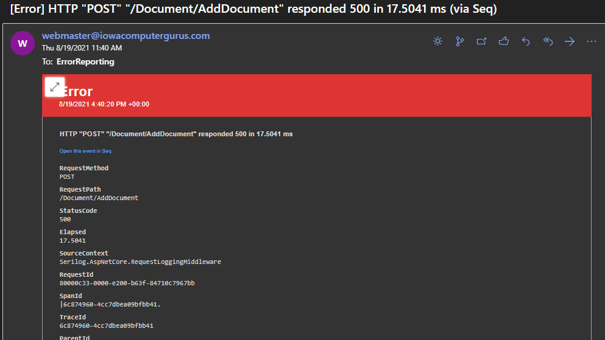

Slide 14
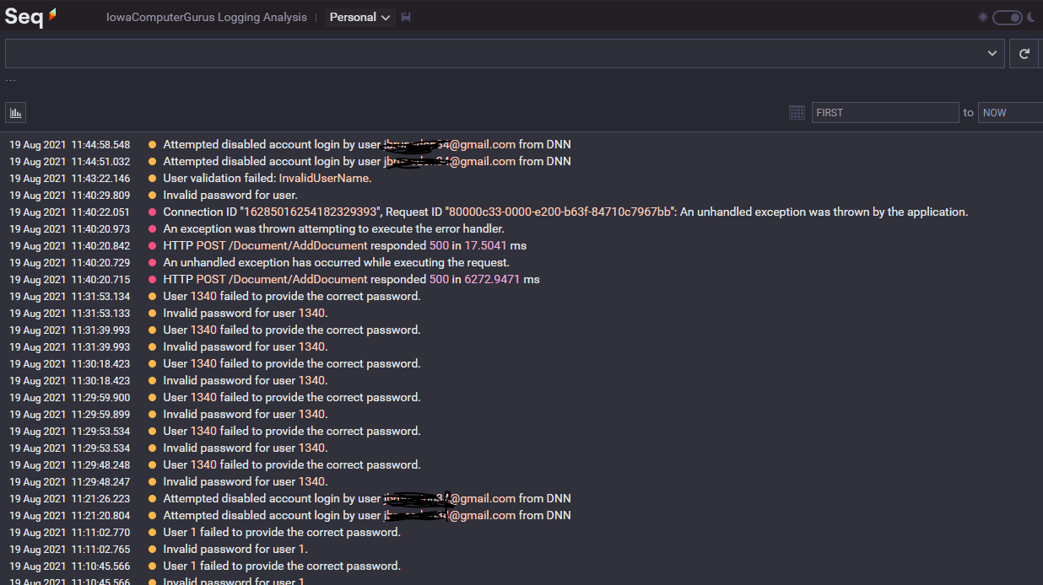
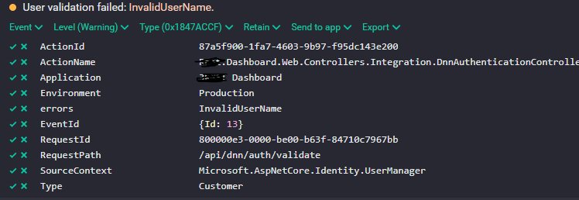
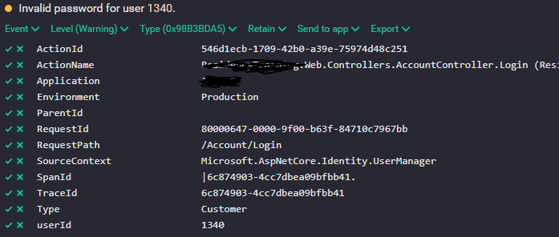

Slide 15
Combined Log Stream Benefits
Logging can often expose bottlenecks, or optimizations that are missed
EF Core for example logs out “optimizations” on model start
ASP.NET logs individual timestamps for entry/exit and processing
Serilog can create a streamlined single-message duration
Can log things for diagnostic purposes
EF Core can log all actual executed SQL
Routing logs how/why a route was matched
Full breadcrumb traffic patterns

Slide 16
Message Format: ToString() vs Dump
_logger.LogInformation("User Information {User}", Request);
[10:49:27 acd7bc9a-669d-4af5-9d4d-530b65966ef4 INF] User Information Microsoft.AspNetCore.Http.DefaultHttpRequest
_logger.LogInformation("Full User Identity Details {@User}", User.Identity);
[10:49:27 acd7bc9a-669d-4af5-9d4d-530b65966ef4 INF] Full User Identity Details {"AuthenticationType":null,"IsAuthenticated":false,"Actor":null,"BootstrapContext":null,"Claims":[],"Label“….

Slide 17
Minimal .NET Core Setup
Add Serilog.AspNetCore Package
Add a configuration (JSON or Otherwise)
Add at least 1 sink (target) to the logging configuration
The sample application has two examples included
https://github.com/mitchelsellers/dotnetcoreloggingdemo

Slide 18
Resources
GitHub Repository: https://github.com/mitchelsellers/dotnetcoreloggingdemo
EF Core Logging Details: https://docs.microsoft.com/en-us/ef/core/miscellaneous/logging
SeriLog Info: https://www.nuget.org/packages?q=Tags%3A%22serilog%22
Seq Info: https://www.datalust.co

Slide 19
Code, Code, Code!
Lets Demo!

